Slide 1
Cyber crisis management: readiness, response and recovery
Lecture 7

Slide 2
Contents:
1. Backup information.
2. IT disaster recovery plan.
3. Risk mitigation.
4. Cyber forensics.
5. Information security incident management
6. Categories and signs of incidents
7. Incident management practices and regulations
8. Stages of functioning of information security incident management system
9. Management processes
10. Difficulties of information security incident management

Slide 3
Incident lifecycle consists of the following phases
occurrence – an unplanned disruption to an agreed service;
detection – a process which occurs sometime after the occurrence of an event;
diagnostics – identification of the characteristics of the incident;
repair – a process of reconfiguring attacked items;
recovery – a process of restoring the failed items to their last recoverable state;
restoration – a process of providing an expected service back to a user;
closure – the final step in the incident lifecycle, during which a user and an incident handler check that a service is fully available

Slide 4
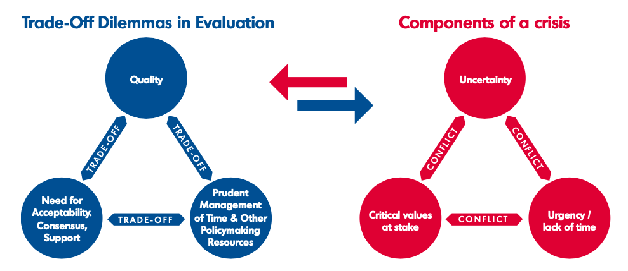
Characteristics of crises vs. normal decision-making

Slide 5
Cyber crisis
An abnormal and unstable situation that threatens an organisation’s strategic objectives, reputation or viability. An event that strikes at the heart of the organization
A serious threat to the basic structures or the fundamental values and norms of a system (in cyber space), which, under time pressure and highly uncertain circumstances, necessitates making vital decisions

Slide 6
1. Backup information
Protection for every computer
Benefits of cloud backup
Runs automatically
Prioritizes easy recovery

Slide 7
Full Backups of Essential Business Data
Encrypted backup of data at least once a month, shortly after a complete malware scan
Store these backups at a protected, off-site location
Focus on the data

Slide 8
Data to back up
Word processing documents and electronic spreadsheets
Databases, especially customer relationship management (CRM), financial, human resource (HR), and accounts receivable (AR)/payable (AP) files
Product design and manufacturing data associated with or related to CAD/CAE/CAM, process plans, tooling and other inventory information, production scheduling, inspection, maintenance, big data, work orders, scheduling
Other operational technology (OT) data such as machine and process condition monitoring and analysis
System logs and other information technology information

Slide 9
Incremental Backups of Important Business Information
Plan automatic incremental or differential backups at least once a week
Check your storage capacity
For extra redundancy, store your backups in multiple locations
Incremental backups to ensure you can read your data and use that information in the event of a security breach

Slide 10
Cyber Insurance for Increased Recovery Capability
Covers costs of:
Cybersecurity expertise to assist in identifying the extent of damage caused
Consultation to help investigate the incident and report it to the appropriate authorities
Loss of revenue due to downtime
Legal fees, fines, and penalties incurred

Slide 11
Backup strategy:
Define your Recovery Time Objectives (RTO) and Recovery Point Objectives (RPO)
Follow the 3-2-1 rule: keep 3 copies of any important file (1 original and 2 backups), store your backups on 2 different types of media (for example on disk and tape or on disk and in the cloud), and store 1 backup offsite, at a physically separate location from your original data
Restore procedure testing

Slide 12
2. IT Disaster recovery plan
Consider what processes in your business are essential and need to be restored fastest
How long you can survive without these processes (the recovery time objective)
Business impact analysis – meaning work out what the downtime will cost in terms of sales, website traffic, customer service
Source the last point at which all your data was backed-up or replicated
How much time has passed between then and the system problem you’re having now – the recovery point objective
Create a ‘risk and impact’ chart and test a possible fix by comparing the current state of your systems against the desired state.

Slide 13
Disaster recovery plan
Has a clear owner
Involves many partners from across the business
Is simple to execute
Leverages a comprehensive, multilayered approach
Is regularly practiced and continuously updated

Slide 14
Recovery goals
Minimize disruption to normal operations
Contain and minimize damage
Ensure operational continuity
Quickly and smoothly restore normal services
Define recovery priorities

Slide 15
Vital assets
Hardware
Software
Data
Digital assets

Slide 16
3. Risk mitigation
Risk Mitigation involves methods that reduce the severity of the loss or decrease the likelihood of the loss from occurring.
Risk mitigation is a process whereby an enterprise takes some proactive measures or use some strategies to mitigate or eliminate risks altogether in order to prevent or reduce damage to the organization.
The incident-response activities should strategize risk management by minimizing legal, operational, and reputational risk.
An effective incident-handling program would help minimize the impact of further attacks and strengthen security controls.

Slide 17
Incident Response to Mitigate Risk
Quick Response
Not an Isolated Event
An incident response plan should include the following:
· Communication guidelines
· Policies, procedures, and agreements for incident-response management
· Indicators of compromise for preparation of investigations
· Preparing a proactive security team based on operational threat hunting exercises
Communication
Eliminating Root Cause
Post-Incident Analysis

Slide 18
4. Cyber forensics
Digital forensics is the method of covering the investigation and recovery of things that are found in digital devices to identify and recover any criminal or hacking activity.
Forensics involves a thorough examination of the data in order to gain a complete understanding of the breach in order to remediate the attack and prevent a recurrence.
Cyber forensics is the process by which experts collect, examine, and analyze all of the data from compromised computer systems and storage devices.
Evidence collection includes identifying and securing infected devices and all data, including latent data, from the systems.
Once the evidence is collected and evaluated, it undergoes a detailed analysis

Slide 19
Digital forensic investigation
IT forensic investigation services cover the following specializations:
Computer forensics: Servers, clients (PCs and notebooks), peripheral devices
Network forensics: Network components (routers, switches, firewalls, etc.)
Mobile forensics: Smartphones, tablets, PDAs, cell phones

Slide 20
5. Information security incident management
Incident Management provides the capability to anticipate and plan for unexpected large- scale crisis events that require prompt and effective response
The objective of Incident Management is to restore normal operations as quickly as possible with the least possible impact on either the business or the user, at a cost- effective price

Slide 21
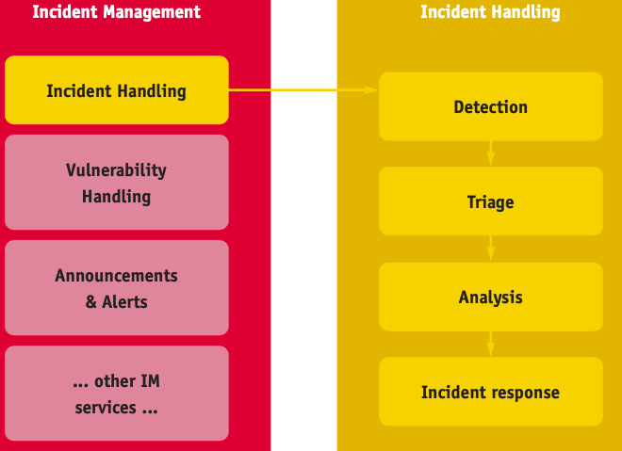
Incident management and incident handling

Slide 22
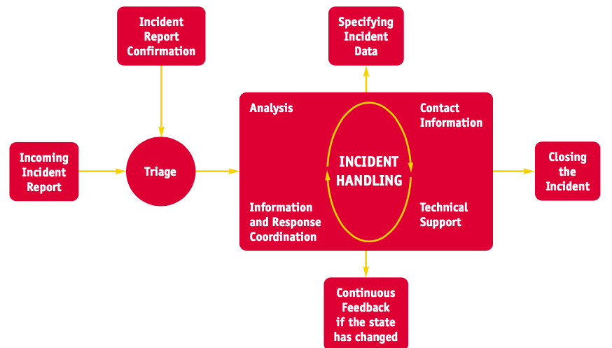
Incident handling process

Slide 23
Operational incident management
A service level agreement between the provider and the customer that defines incident priorities, escalation paths, and response/resolution time frames
Incident models, or templates, that allow incidents to be resolved efficiently
Categorization of incident types for better data gathering and problem management
Agreement on incident statuses, categories, and priorities
Establishment of a major incident response process
Agreement on incident management role assignment

Slide 24
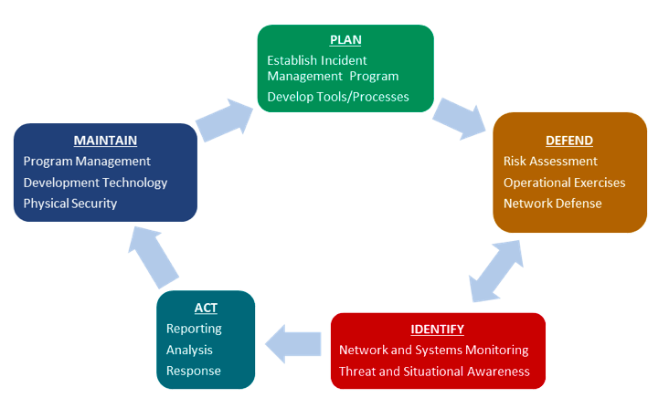
Incident Management Lifecycle

Slide 25
6. Categories and signs of incidents
Security incidents are events that may indicate that an organization's systems or data have been compromised or that measures put in place to protect them have failed.
A security event is anything that has significance for system hardware or software, and an incident is an event that disrupts normal operations.
Security events are usually distinguished from security incidents by the degree of severity and the associated potential risk to the organization.

Slide 26
How to detect security incidents
Unusual behavior from privileged user accounts
Unauthorized insiders trying to access servers and data
Anomalies in outbound network traffic
Traffic sent to or from unknown locations
Excessive consumption
Changes in configuration
Hidden files
Unexpected changes
Abnormal browsing behavior
Suspicious registry entries

Slide 27
Common security incident types
1. Unauthorized attempts to access systems or data
2. Privilege escalation attack
3. Insider threat
4. Phishing attack
5. Malware attack
6. Denial-of-service (DoS) attack
7. Man-in-the-middle (MitM) attack
8. Password attack
9. Web application attack
10. Advanced persistent threat (APT)

Slide 28
7. Incident management practices and regulations

Slide 29
Incident Handling Process
Incident report
Registration
Triage
Incident verification
Incident initial classification
How to prioritise actions within your constituency
Incident assignment
Incident resolution

Slide 30
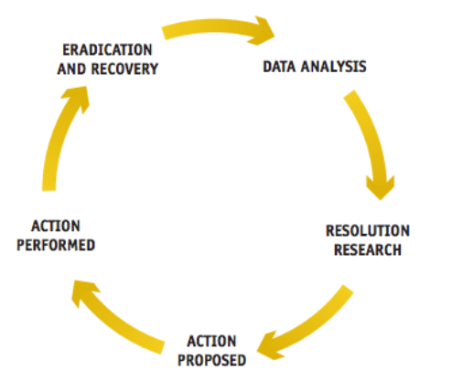
8. Stages of functioning of information security incident management system

Slide 31
Data Analysis
Incident reporter – depending on how much information was given in the initial report you should ask for additional data you need, such as:
detailed contact information
detailed description of the incident
incident classification suggested by the incident reporter o logs
the exact time of the incident
operating systems and network setup
security systems setup (e.g. antivirus software or firewall) o incident severity (in the incident reporter’s opinion).
Monitoring systems – try to search for information related to the IP addresses involved in your network monitoring systems (e.g. netflow database).
Referring database – check if this kind of incident or this incident reporter are already in your incident database. By doing this you can learn a lot and speed up the resolution of the incident.
Other sources – relevant log-files (routers, firewalls, proxy servers, switches, web application, mail servers, DHCP servers, authentication servers, etc.).

Slide 32
Action Proposed
How to stop and mitigate an ongoing attack:
turn off a service
check the system for malware
patch a system or an application
perform or order an audit if you are not able to improve your system security yourself.
How to deliver more data:
concrete practical instructions (e.g. how to obtain a full e-mail header); having some of your most often used instructions ready and available on your website is good as then it is enough just to point links to them.

Slide 33
Action Proposed
ISP/ICP (In System Programming/In Circuit Programming)
To collect, save and archive data. Some of this data can be available without any special restrictions; other data requires special protection (e.g. personal data) – in this case all you can ask for is for the data to be saved so that it is available if the target of the attack reports a case to the police.
To monitor network traffic related to the case and inform you if something important happens.
To filter network traffic in the case of an ongoing attack if such filtering can help to stop or mitigate it.

Slide 34
Action Proposed
Source of an incident (the attacker)
To advise and propose similar actions to those given to the attack target (see above).
DO NOT contact the source of the incident if you suspect that you may be contacting a real criminal. Notifying a potential attacker that someone is aware of his or her activities could decrease the effectiveness of the investigation.

Slide 35
Action performed
Monitor technically whatever you are able to monitor, for example:
o Is the attack target’s service turned off? o Is the attack target’s service still vulnerable? o Is the traffic which should be filtered still visible in the network? o Other responses can be checked by traditional means such as e-mail, phone or any other kind of direct contact. Ask what has been done.

Slide 36
Eradication and recovery
For example: it means that the application is working again, e-mails are reaching mailboxes, a website is available once more and displays proper content with proper response times, a computer is not part of a DDoS army and is not sending spam, etc.
An attacked system now does what it should do and not what it should not do. If you have doubts that you eradicated a problem and recovered a service, it is good practice to check yourself as much as possible and/or get a positive confirmation from each party that in their opinion everything is operating normally again.

Slide 37
9. Management processes
Incident identification
Incident logging (An incident can be logged through phone calls, emails, SMS, web forms)
Incident categorization (based on the area of IT or business that the incident causes a disruption in like network, hardware etc.)
Incident prioritization (critical, high, medium, low)
Escalation, as necessary, to level 2 support
Incident resolution
Incident closure (an incident can be closed once the issue is resolved)
Communication with the user community throughout the life of the incident

Slide 38
Incident prioritization
1. Low-priority incidents are those that do not interrupt users or the business and can be worked around. Services to users and customers can be maintained.
2. Medium-priority incidents affect a few staff and interrupt work to some degree. Customers may be slightly affected or inconvenienced.
3. High-priority incidents affect a large number of users or customers, interrupt business, and affect service delivery. These incidents almost always have a financial impact.

Slide 39
Incident resolution
1. Initial diagnosis: This occurs when the user describes his or her problem and answers troubleshooting questions.
2. Incident escalation: This happens when an incident requires advanced support, such as sending an on-site technician or assistance from certified support staff.
3. Investigation and diagnosis: These processes take place during troubleshooting when the initial incident hypothesis is confirmed as being correct.
4. Resolution and recovery: This is when the service desk confirms that the user’s service has been restored to the required SLA level.
5. Incident closure: At this point, the incident is considered closed and the incident process ends.

Slide 40
10. Difficulties of information security incident management
Volume of risks faced
Shifting privacy requirements
Threats posed by insiders
Deficiencies in information
Tight budget constraintS

Slide 41
References:
Computer Security Fundamentals: Computer Security Fundamentals, 2/Edition, William (Chuck) Easttom, II. (2012, Pearson Education Company), ISBN-13:9780789748904
Incident Handling Management, ENISA, 2016
“ENISA Good Practice Guide for Incident Management” : https://www.enisa.europa.eu/publications/good-practice-guide-for-incident-management
Security Incidents: Types of Attacks and Triage Options, https://cybersecurity.att.com/resource-center/ebook/insider-guide-to-incident-response/types-of-security-incidents
10 types of security incidents and how to handle them, https://searchsecurity.techtarget.com/feature/10-types-of-security-incidents-and-how-to-handle-them
Cracking Stuxnet: a 21st century cyber weapon, https://www.ted.com/talks/ralph_langner_cracking_stuxnet_a_21st_century_cyber_weapon?language=en

